Slide 1
PROJECT: HIGH CLOUD AIRLINE(P 605)

Slide 2
Group Members(Group 6):
Anant Raj
Poojitha P
Prachi Raj
Rajaram Setty C V
Shruti Tatyasaheb Deshpande
Sravanthi C
Vijay Vasant More

Slide 3



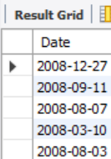
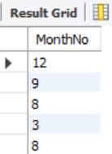
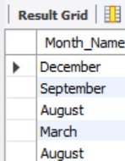
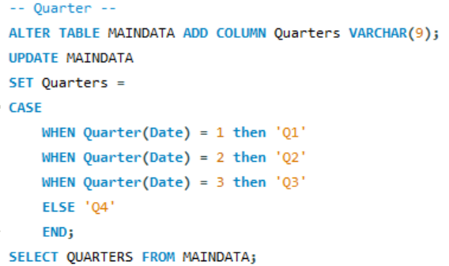


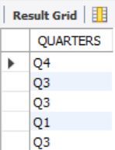
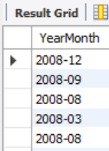
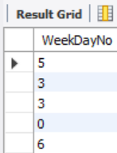
KPI 1 – Various fields calculation

Slide 4



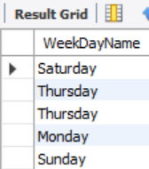
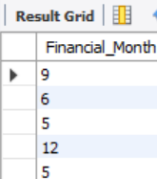
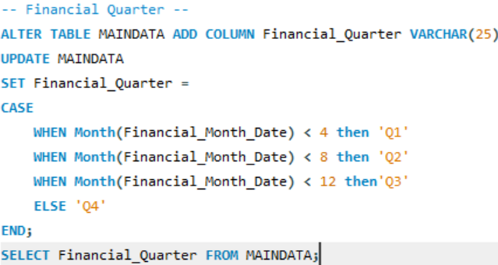
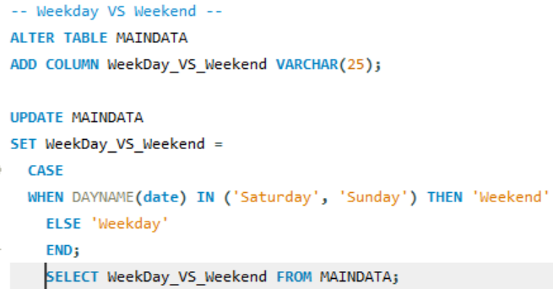
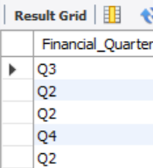
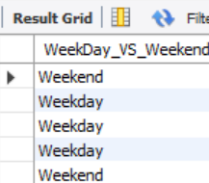
KPI 1 – Various fields calculation(Contd)

Slide 5
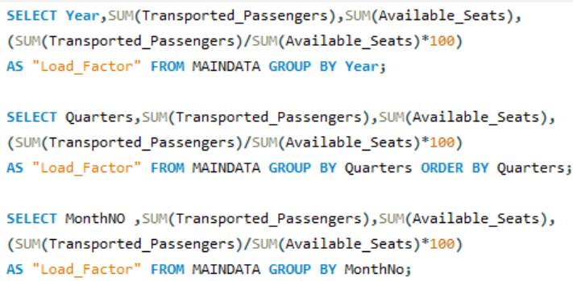


KPI 2 – Load Factor Percentage yearly, quarterly and monthly

Slide 6


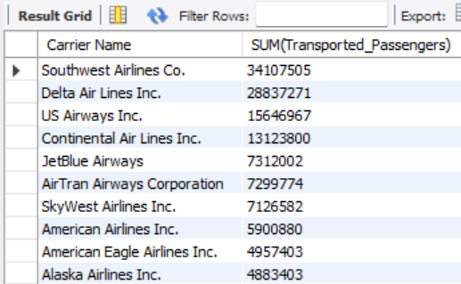
KPI 3 - Load Factor Percentage Carrier Name basis
KPI 4 – Top 10 carrier basis passengers preference

Slide 7
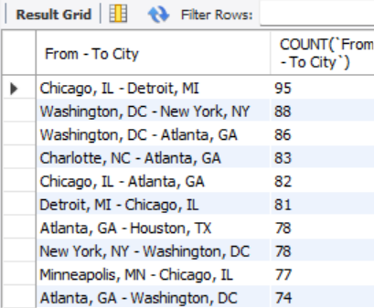


KPI 5 – Top routes basis number of flights(from – to city)
KPI 6 – Load factor weedays vs weekends

Slide 8

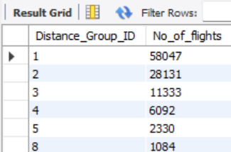


KPI -7 number of flights basis distance group
KPI - 8 filter

Slide 9
THANK YOU

